Slide 1
DATA ANALYTICS PROJECT
Supermart Grocery
Sales Analysis
Tools Used:
Excel
SQL
Python
Power BI
Soham Sutar
March 2026

Slide 2
Introduction
Role of Data Analytics in Retail
Dataset Overview
Data analytics empowers retail businesses to make informed decisions. By analyzing sales patterns, customer behavior, and inventory data, retailers can optimize pricing, plan promotions, and improve supply chain efficiency.
The Supermart grocery sales dataset contains detailed transactional records including order details, customer information, product categories, regions, sales figures, discounts, and profit data.
KEY DATA FIELDS
▸ Order ID
▸ Order Date
▸ Customer Name
▸ Region
▸ Category
▸ Sub-Category
▸ Sales
▸ Profit
▸ Discount
🎯 OBJECTIVE: Analyze sales performance, category trends, and regional insights to support data-driven business decisions.

Slide 3
Problem Statement & Business Questions
Supermart requires a comprehensive analysis of its grocery sales data to identify performance gaps, understand customer behavior, and uncover growth opportunities across regions and product categories.
Business Questions to Answer:
📈
Q1. What are the monthly sales trends?
🏷️
Q2. Which categories generate the highest revenue?
🗺️
Q3. How do different regions perform in terms of sales?
👥
Q4. Who are the top customers?
💰
Q5. What is the overall profit margin?

Slide 4
Data Cleaning using Excel
01
Import & Delimiter Fix
02
Remove Duplicates
03
Handle Missing Values
Imported CSV and resolved delimiter issues using Text to Columns wizard
Used Remove Duplicates feature to eliminate redundant rows from the dataset
Identified and handled null values in Order Date, Sales, and Category columns
04
Fix Date Formats
05
Create Date Columns
06
Validate with Pivot
Standardized inconsistent date formats using Text to Columns + DATEVALUE()
Added Month and Year columns using TEXT() and YEAR() formulas for grouping
Validated data accuracy via Pivot Table to check monthly sales trends

Slide 5
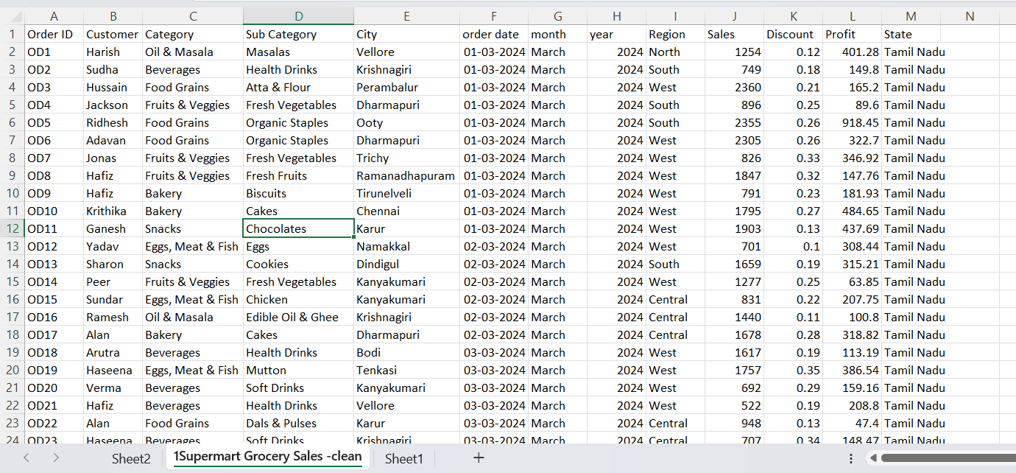

Slide 6
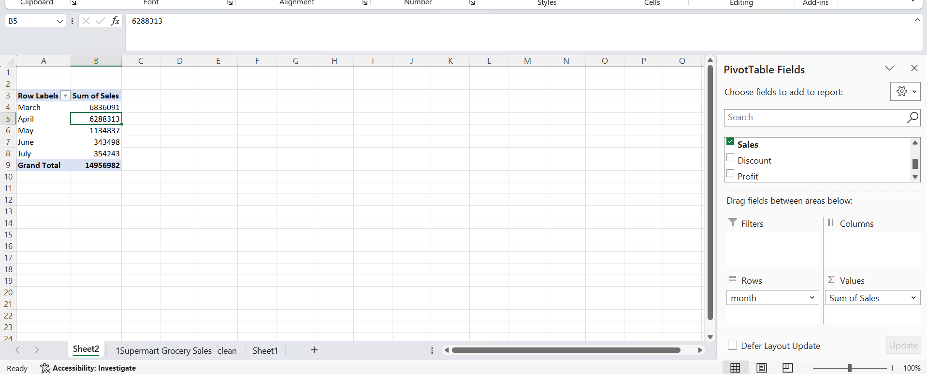
Pivot table

Slide 7
Data Analysis using SQL
Total Sales
Category-wise Sales
Region-wise Sales
SELECT SUM(Sales) AS Total_Sales FROM supermart;
SELECT Category, SUM(Sales) AS Sales
FROM supermart GROUP BY Category;
SELECT Region, SUM(Sales) AS Sales
FROM supermart GROUP BY Region;
Top 5 Customers
Profit Analysis
SELECT Customer_Name, SUM(Sales) AS Sales
FROM supermart
ORDER BY Sales DESC LIMIT 5;
SELECT SUM(Profit) AS Total_Profit,
ROUND(AVG(Profit), 2) AS Avg_Profit
FROM supermart;
📌 Screenshot Placeholder — SQL Query Results (Add screenshots of query outputs from MySQL / PostgreSQL / SQLite here)

Slide 8
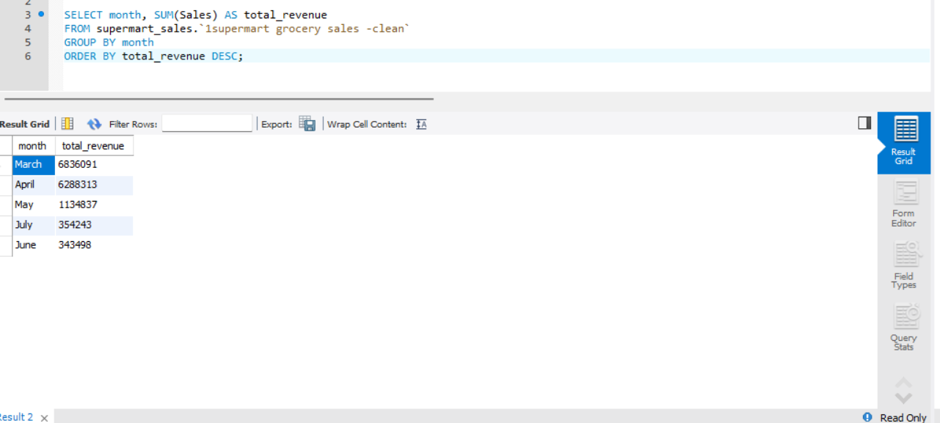

Slide 9
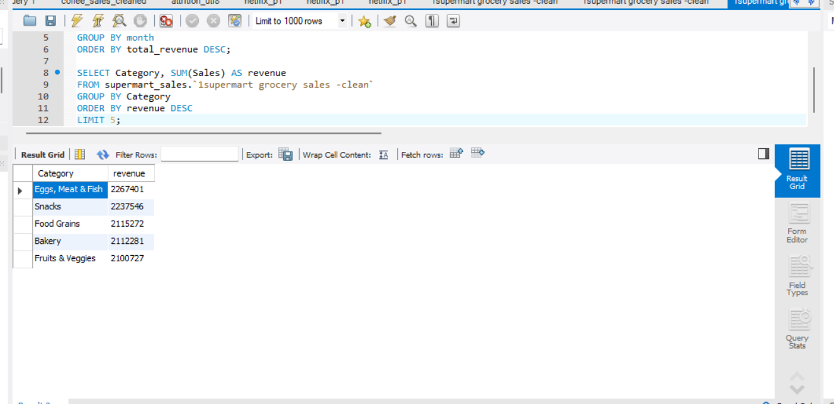

Slide 10
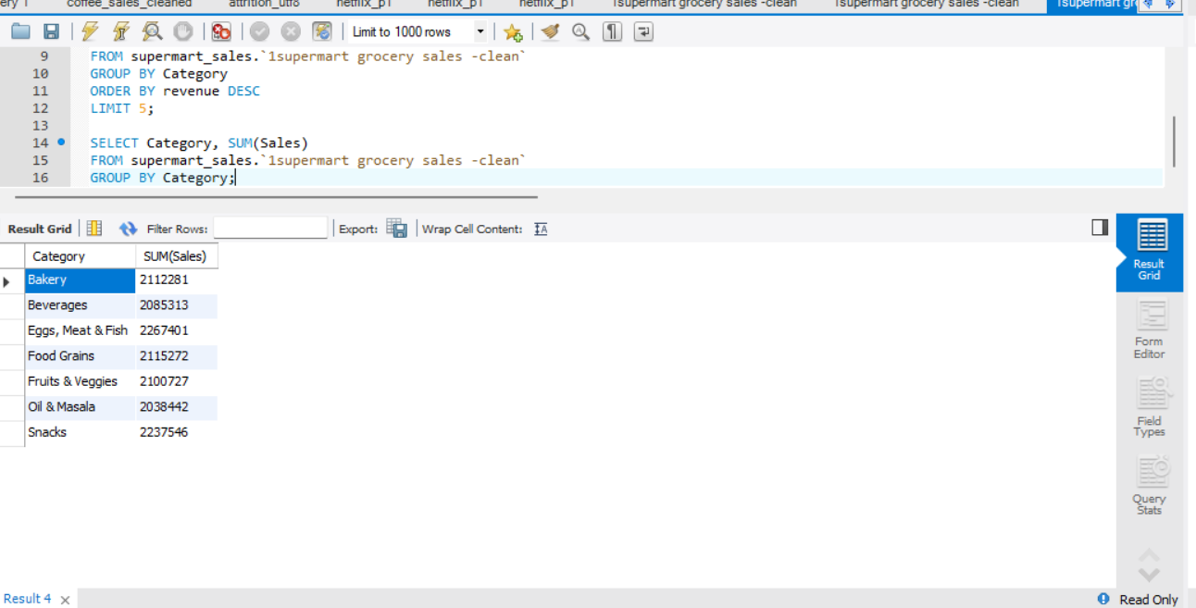

Slide 11
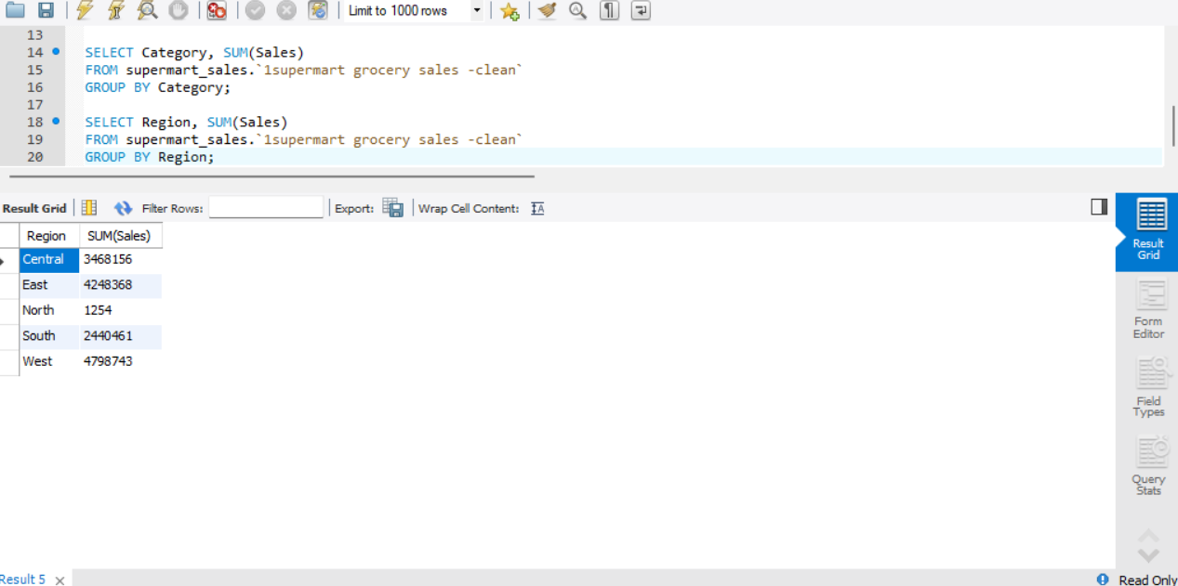

Slide 12
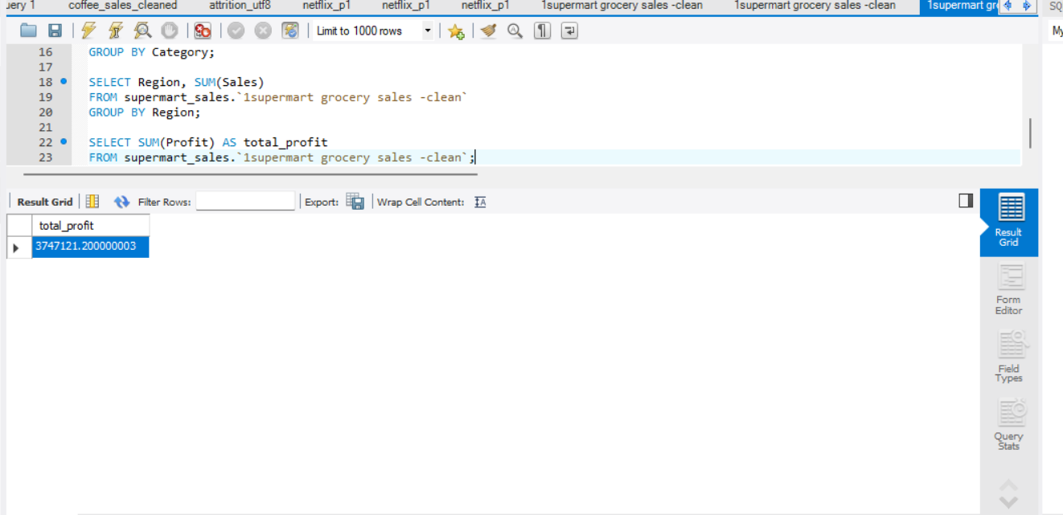

Slide 13
Exploratory Data Analysis using Python
LIBRARIES USED
📈 Line Chart
📊 Bar Chart
📊 Bar Chart
▸ Pandas — Data manipulation & aggregation
📌
Chart
Screenshot
📌
Chart
Screenshot
📌
Chart
Screenshot
▸ Matplotlib — Chart creation & styling
▸ Seaborn — Statistical visualizations
▸ NumPy — Numerical computations
Monthly Sales Trend
Category-wise Sales
Region-wise Sales
📉 Histogram
⬡ Scatter Plot
📌
Chart
Screenshot
📌
Chart
Screenshot
Sales Distribution
Profit vs Sales

Slide 14
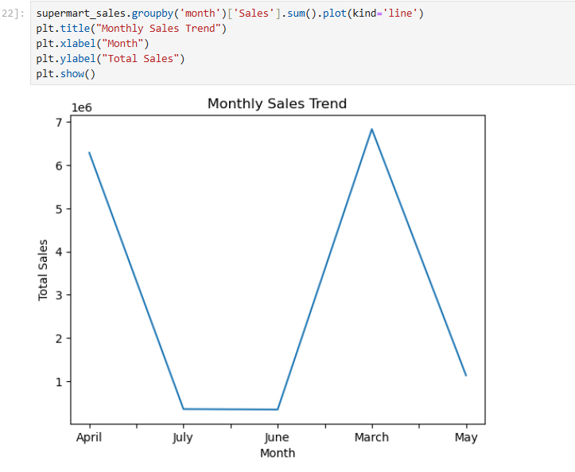
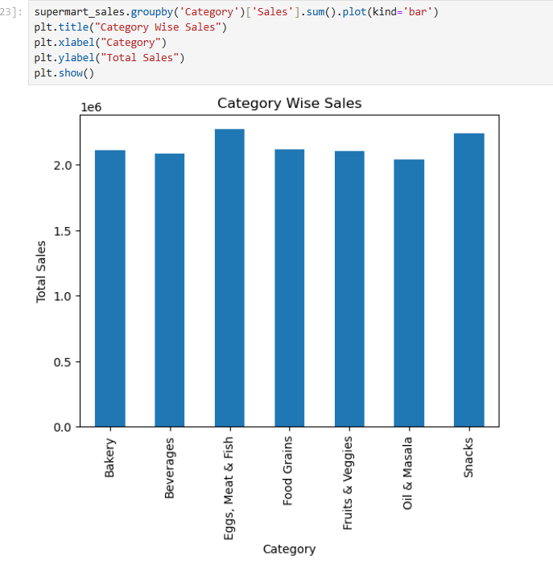
Monthly Sales Trend
Category-wise Sales

Slide 15
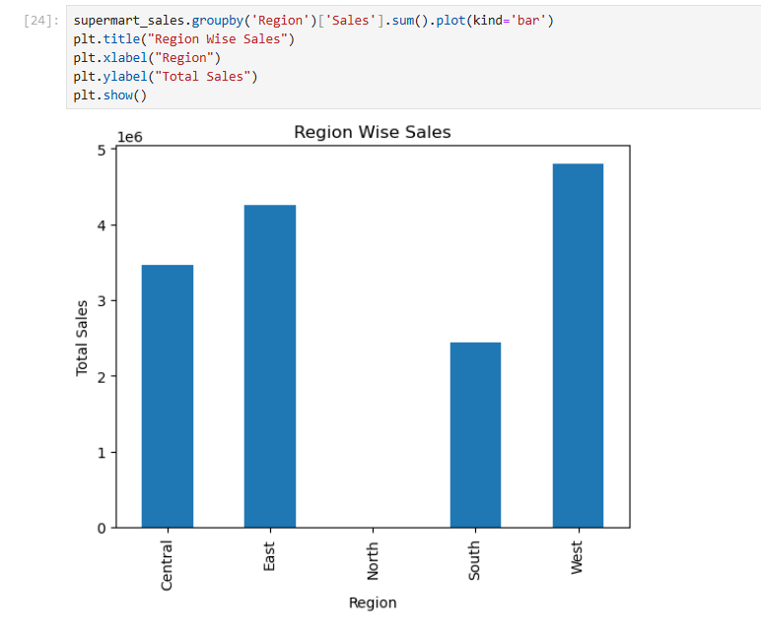
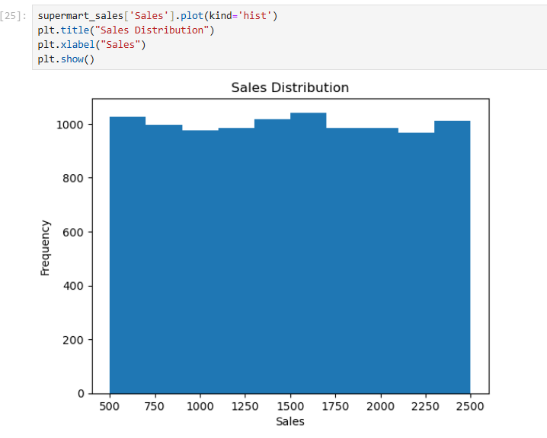
Region-wise Sales
Sales Distribution

Slide 16
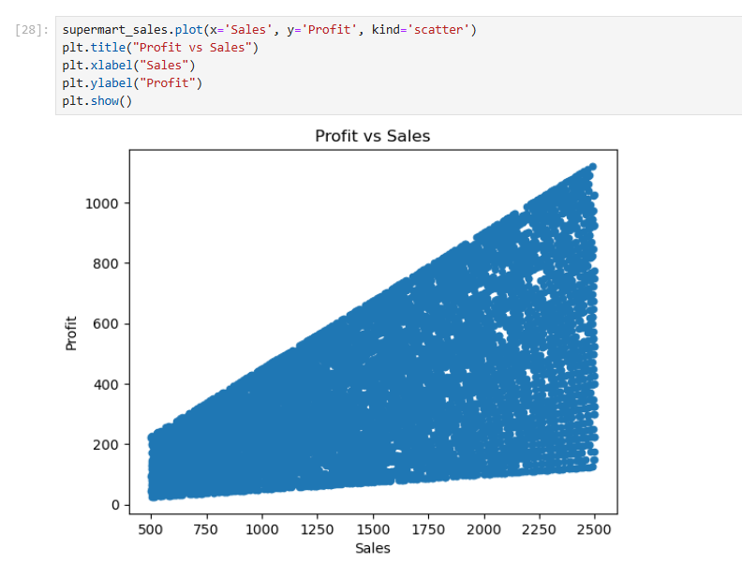
Profit vs Sales

Slide 17
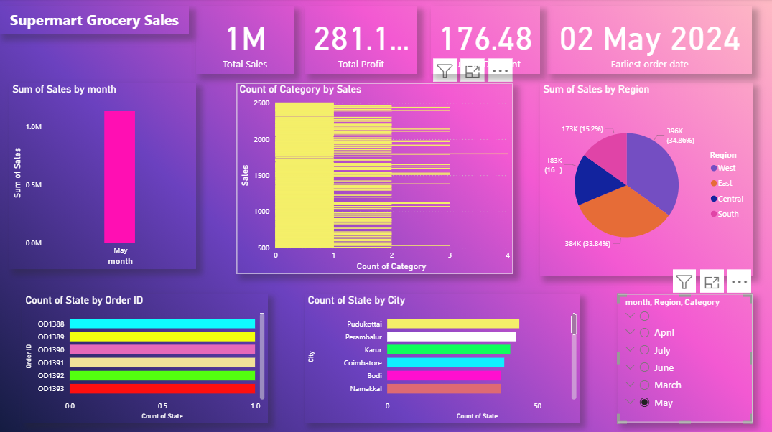
Power BI Dashboard

Slide 18
Key Insights
01
🛒 Food & Beverages categories generate the highest sales volume across all product segments
02
🗺️ North & South regions contribute the most revenue — together accounting for majority share
03
📅 Sales peak during festive months (October–December) driven by seasonal demand
04
⭐ Top 5 customers contribute a significant share of total revenue — high loyalty value
05
💹 Overall profitability is healthy and consistent across all major product categories

Slide 19
Business Recommendations
📍 Target Low-Performing Regions
🏷️ Boost Top Category Sales
🎁 Launch Customer Loyalty Program
Increase marketing and promotional spend in East & West regions to capture untapped revenue potential and improve regional balance.
Promote high-performing Food & Beverage categories with targeted discounts and bundle offers during high-traffic periods.
Introduce a rewards program for top customers to improve retention, increase lifetime value, and encourage repeat purchases.
📦 Optimize Inventory for Peak Season
📲 Deploy Real-Time Dashboards
Increase stock levels and logistics capacity during October–December to meet festive season demand and minimize stockouts.
Use interactive Power BI dashboards for live performance monitoring, enabling faster and more informed business decisions.

Slide 20
Conclusion
Successfully analyzed Supermart grocery sales data end-to-end using Excel, SQL, Python, and Power BI.
✅
Derived actionable insights on category performance, regional sales trends, and customer buying behavior.
📊
Built an interactive Power BI dashboard enabling real-time monitoring and data-driven decision support.
🖥️
Demonstrated complete data analytics skills covering data cleaning, querying, EDA, and visualization.
🎓
🎯 End-to-End Data Analytics Project | Soham Sutar | March 2026

